Slide 1
Android Adapters
Mobile (Android)
Application Development

Slide 2


List View & Grid View
List View
Grid View
Displays a scrolling single column list.
Displays a scrolling grid of columns and rows.
Notes:
GridView and ListView are taking data from somewhere and then showing in List or Grid view

Slide 3
List View & Grid View
The content for “List View” & “Grid View” is dynamic.
These are populated with views at runtime.

Slide 4
List View & Grid View
In order to implement functionality:
Add each view item inside the List or Grid.
Populate each view item with content.
Since we can have many items inside List or Grid, we may need to implement scrolling & pagination.
We also have to write additional code to identify the click event on a particular item.
Notes:
All items are of the same type

Slide 5
List View & Grid View
Note that items in both the List & Grid:
Are of same type. i.e., TextView, ImageView, etc.
Need to be accessed and added at runtime from some data source for example, array, database, etc.

Slide 6
What We Need?
We need Android Framework to provide us with:
An object that can:
Provide access to the data items.
Be responsible for making a View for each item in the data set.
A ViewGroup:
Whose children are determined by the above object.
That provides mechanism to handle click event on particular list items.
That takes care of scrolling & pagination.
Notes:
Values in form get from user and contained in data object to be send to database layer

Slide 7
Good News!
Android Framework provides us with:
Adapter Class:
Provides access to the data items.
Responsible for making a View for each item in the data set.
AdapterView Class:
Whose children are determined by an Adapter.
Provide mechanism to handle click event on particular list items.
Takes care of scrolling & pagination.
ListView & GridView are subclasses of AdapterView.
Notes:
Adapter talks to data, gets/fetches data

Slide 8
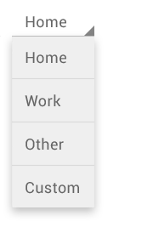
Spinner
Spinner and Gallery (Gallery has been deprecated since API 16) are also commonly used subclasses of AdapterView.
Spinners provide a quick way to select one value from a set. In the default state, a spinner shows its currently selected value. Touching the spinner displays a dropdown menu with all other available values, from which the user can select a new one.
Notes:
Spinner is an adapter view – it talks to adapter and adapter talks to source

Slide 9
Adapter
An Adapter object acts as a bridge between an AdapterView and the underlying data for that view.
The Adapter provides access to the data items.
The Adapter is also responsible for making a View for each item in the data set.

Slide 10
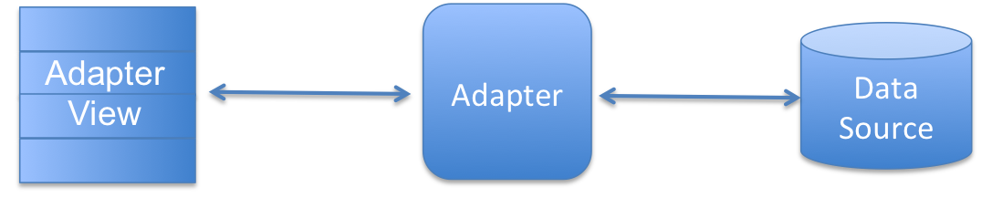
Adapter (Conceptual Diagram)
List View
Grid View
Spinner
ArrayAdapter
SimpleCursorAdapter
Array
Database
Notes:
ArrayAdapter
You can use this adapter when your data source is an array. By default, ArrayAdapter creates a view for each array item by calling toString() on each item and placing the contents in a TextView. Consider you have an array of strings you want to display in a ListView, initialize a new ArrayAdapter using a constructor to specify the layout for each string and the string array −
ArrayAdapter adapter = new ArrayAdapter<String>(this, R.layout.ListView, StringArray);

Slide 11
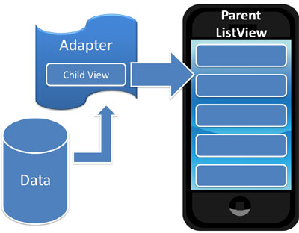
Adapter (Conceptual Diagram)

Slide 12
Using Adapter & AdapterView
Add AdapterView to Activity (i.e., Add in XML Layout) – list, grid, spinner
Define Date Source (e.g. Array in Code or in XML “string-array”)
Create Adapter (e.g., ArrayAdapter)
Specify context, layout to be used for each view, and the string array
Get reference to AdapterView (use findViewById() method)
Set Adapter on Adapter View (use setAdapter() method)
Set Event Listener (if needed. e.g., onItemClick())
Notes:
Inflater convert the XML resource into a programmable object

Slide 13
ArrayAdapter
Consider you have an array of strings you want to display in a ListView, initialize a new ArrayAdapter using a constructor to specify the layout for each string and the string array −
ArrayAdapter adapter = new ArrayAdapter<String>(this, R.layout.ListView, StringArray);
Parameters of Array Adapter
this is the application context.
R.layout.ListView is defined in XML file and having TextView for each string in the array.
StringArray is an array of strings which will be populated in the text view.
Notes:
Once you have array adapter created, then simply call setAdapter() on your ListView object as follows −
ListView listView = (ListView) findViewById(R.id.listview);
listView.setAdapter(adapter);

Slide 14
ArrayAdapter Examples
List View
Grid View
Spinner

Slide 15
Example: List View With Array Adapter

Slide 16
1. Add AdapterView
<RelativeLayout
... >
<ListView
android:id="@+id/listView1"
android:layout_width="match_parent"
android:layout_height="wrap_content"
android:layout_alignParentLeft="true"
android:layout_alignParentTop="true" >
</ListView>
</RelativeLayout>

Slide 17
2. Define Date Source
String[] months = {"January", "February", "March", "April", "May", "June", "July", "August", "September", "October", "November", "December"};

Slide 18
3. Create Adapter
ArrayAdapter<String> adapter = new ArrayAdapter<String>(this, android.R.layout.simple_list_item_1, months);
Notes:
Sspecifying String to the generic adapter.
Android.R.layout.simple_list_item_1 . Android keyword here means we are using android default resource

Slide 19
4. Get reference to AdapterView
ListView listview = (ListView) findViewById(R.id.listView1);

Slide 20
5. Set Adapter on Adapter View
listview.setAdapter(adapter);

Slide 21
6. Set Event Listener
listview.setOnItemClickListener(new OnItemClickListener()
{
public void onItemClick(AdapterView<?> parent, View v, int position, long id) {
Toast.makeText(getApplicationContext(), months[position], Toast.LENGTH_SHORT).show();
}
});
Notes:
Study generics wild cards - * and ?
TOAST vs. Snake bar

Slide 22
ListView with ChoiceMode
<ListView android:id="@+id/listView1" android:layout_width="match_parent" android:layout_height="wrap_content" android:layout_alignParentLeft="true" android:layout_alignParentTop="true" android:divider="@color/colorAccent" android:dividerHeight="1dp“
android:choiceMode="multipleChoice> </ListView>

Slide 23
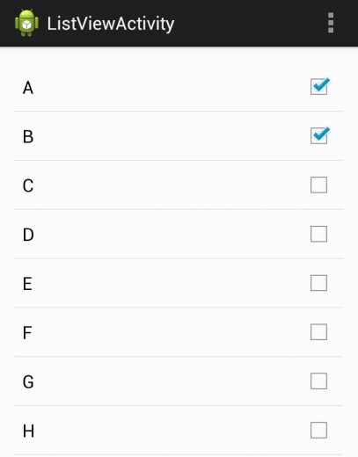
ListView with ChoiceMode
ArrayAdapter<String> adapter = new ArrayAdapter<String>(this, android.R.layout.simple_list_item_multiple_choice, data);

Slide 24
Example: Grid View With Array Adapter

Slide 25
1. Add AdapterView
<RelativeLayout
... >
<GridView
android:id="@+id/gridView1"
android:layout_width="match_parent"
android:layout_height="wrap_content"
android:layout_alignParentLeft="true"
android:layout_alignParentTop="true"
android:numColumns="3" >
</GridView>
</RelativeLayout>

Slide 26
2. Define Date Source
In “strings.xml” File:
<string-array name="alphabets_array">
<item>A</item>
<item>B</item>
<item>C</item>
. . .
<item>Z</item>
</string-array>

Slide 27
2. Define Date Source
In Activity’s “.java” File:
// You can declare outside (onCreate) method, But don’t initialize
String[] alphabets;
// Get values from XML resource file
alphabets = getResources().getStringArray(R.array.alphabets_array);

Slide 28
3. Create Adapter
ArrayAdapter<String> adapter = new ArrayAdapter<String>(this, android.R.layout.simple_list_item_1, alphabets);

Slide 29
4. Get reference to AdapterView
GridView gridview = (GridView) findViewById(R.id.gridView1);

Slide 30
5. Set Adapter on Adapter View
gridview.setAdapter(adapter);

Slide 31
6. Set Event Listener
gridview.setOnItemClickListener(new OnItemClickListener()
{
public void onItemClick(AdapterView<?> parent, View v, int position, long id)
{
Toast.makeText(getApplicationContext(), "You Clicked: " + alphabets[position], Toast.LENGTH_SHORT).show();
}
});

Slide 32
Example: Spinner With Array Adapter

Slide 33
1. Add AdapterView
<RelativeLayout
... >
<Spinner
android:id="@+id/spinner1"
android:layout_width="wrap_content"
android:layout_height="wrap_content"
android:layout_alignParentLeft="true"
android:layout_alignParentTop="true" />
. . .
</RelativeLayout>

Slide 34
2. Define Date Source
In “strings.xml” File:
<string-array name="sports_array">
<item>Badminton</item>
<item>Rugby</item>
<item>Squash</item>
<item>Tennis</item>
<item>Soccer</item>
<item>Field Hockey</item>
<item>Cricket</item>
<item>Basketball</item>
<item>Ice Hockey</item>
<item>Baseball</item>
<item>Cycling</item>
<item>Football</item>
</string-array>

Slide 35
2. Define Date Source
In Activity’s “.java” File:
// You can declare outside (onCreate) method, But don’t initialize
String[] sports;
// Get values from XML resource file
sports = getResources().getStringArray(R.array. sports_array);

Slide 36
3. Create Adapter
ArrayAdapter<String> adapter = new ArrayAdapter<String>(this, android.R.layout.simple_spinner_dropdown_item, sports);

Slide 37
4. Get reference to AdapterView
Spinner spinner = (Spinner) findViewById(R.id.spinner1);

Slide 38
5. Set Adapter on Adapter View
spinner.setAdapter(adapter);

Slide 39
6. Set Event Listener
spinner.setOnItemSelectedListener(new AdapterView.OnItemSelectedListener()
{
public void onItemSelected(AdapterView<?> parent, View view, int pos, long id)
{
Toast.makeText(getApplicationContext(), "You Clicked: " + sports[pos], Toast.LENGTH_SHORT).show();
}
@Override
public void onNothingSelected(AdapterView<?> arg0) {
// TODO Auto-generated method stub
}
});

Slide 40
How to Access Spinner Value?
Spinner spinner = (Spinner) findViewById(R.id.spinner1);
int selected_sport = spinner.getSelectedItemPosition();

Slide 41
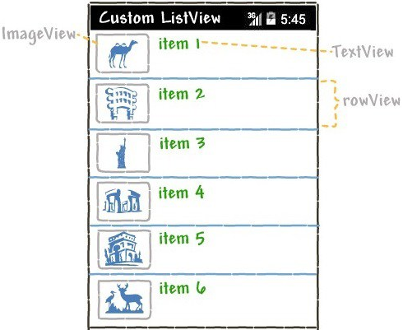
Custom Listview with Image and Text
The standard ListView only displays a list of items.
while it may suffice when you simply need to show a list of text, it’s not enough for more refined applications. in this example, you’ll see how you’ll be able to customize the ListView so that you’ll be able to show pictures, multiple lines of text, and more.

Slide 42
Custom ListView
Most useful widget is the ListView.
By default android renders only a single TextView in each of the ListView's row and binds string data through an adapter.
You can customize the ListView's row and place your own widget items in it and then
bind data through your own
custom adapter.

Slide 43
1. Create Layout with a ListView
Create a simple layout and declare a ListView in it.
<?xml version="1.0" encoding="utf-8"?> <RelativeLayout xmlns:android="http://schemas.android.com/apk/res/android" xmlns:tools="http://schemas.android.com/tools" android:id="@+id/activity_main" android:layout_width="match_parent" android:layout_height="match_parent" android:paddingBottom="@dimen/activity_vertical_margin" android:paddingLeft="@dimen/activity_horizontal_margin" android:paddingRight="@dimen/activity_horizontal_margin" android:paddingTop="@dimen/activity_vertical_margin" tools:context="com.example.android.customviewapplication.MainActivity"> <ListView android:id="@+id/list" android:layout_width="match_parent" android:layout_height="wrap_content" android:layout_alignParentLeft="true" android:layout_alignParentTop="true" > </ListView> </RelativeLayout>

Slide 44
2. Create the layout for listview row
This will be the layout in which you can customize your list row.
This will be re-inflated every time a new entry is made to the listview.
The widgets in this layout will depend on your requirement, like
For example,
If you are developing a contact list then you will only need a ImageView and TextView
If you are developing an animals app then you might consider adding another TextView for the animal description apart from animal icon and animal name.
Notes:
Instantiates a layout XML file into its corresponding View objects. It is never used directly. Instead, use getLayoutInflater() or getSystemService(Class) to retrieve a standard LayoutInflater instance that is already hooked up to the current context and correctly configured for the device you are running on. For example:
LayoutInflater inflater = (LayoutInflater)context.getSystemService(Context.LAYOUT_INFLATER_SERVICE);

Slide 45
2. Create the layout for listview row
<?xml version="1.0" encoding="utf-8"?> <LinearLayout xmlns:android="http://schemas.android.com/apk/res/android" android:layout_width="match_parent" android:layout_height="match_parent" android:orientation="horizontal" > <ImageView android:id="@+id/icon" android:layout_width="60dp" android:layout_height="60dp" android:padding="5dp" /> <LinearLayout android:layout_width="wrap_content" android:layout_height="wrap_content" android:orientation="vertical"> <TextView android:id="@+id/item" android:layout_width="wrap_content" android:layout_height="wrap_content" android:text="Medium Text" android:textAppearance="?android:attr/textAppearanceMedium" android:layout_marginLeft="10dp" android:layout_marginTop="5dp" android:padding="2dp" android:textColor="#33CC33" /> <TextView android:id="@+id/itemDesc" android:layout_width="wrap_content" android:layout_height="wrap_content" android:text="Item Description" android:layout_marginLeft="10dp"/> </LinearLayout> </LinearLayout>

Slide 46
3. Create Custom Adapter
public class CustomListAdapter extends ArrayAdapter<String> { private final String[] itemName; private final int[] imageId; private final String[] itemDescription; public CustomListAdapter(Activity context, int[] imgId, String[] itemNam, String[] itemDesc) { super(context, R.layout.list_item, itemNam); this.imageId = imgId; this.itemName = itemNam; this.itemDescription = itemDesc; } public View getView(int position, View convertView, ViewGroup parent) { View listItemView = convertView; LayoutInflater inflater = (LayoutInflater)context.getSystemService(Context.LAYOUT_INFLATER_SERVICE);
listItemView = inflater.inflate(R.layout.list_item, parent, false);
ImageView imageView = (ImageView) listItemView.findViewById(R.id.icon); TextView itemTitle = (TextView) listItemView.findViewById(R.id.item); TextView descTextView = (TextView) listItemView.findViewById(R.id.itemDesc); imageView.setImageResource(imageId[position]); itemTitle.setText(itemName[position]); descTextView.setText(itemDescription[position]); return listItemView; }; }
Notes:
View inflate (int resource, ViewGroup root, boolean attachToRoot) Inflate a new view hierarchy from the specified xml resource.
Parameters
resource int: ID for an XML layout resource to load (e.g., R.layout.main_page)
root ViewGroup: Optional view to be the parent of the generated hierarchy (if attachToRoot is true), or else simply an object that provides a set of LayoutParams values for root of the returned hierarchy (if attachToRoot is false.)
attachToRoot boolean: Whether the inflated hierarchy should be attached to the root parameter? If false, root is only used to create the correct subclass of LayoutParams for the root view in the XML.
LayoutInflater class is used to instantiate layout XML file into its corresponding View objects.
In other words, it takes as input an XML file and builds the View objects from it.

Slide 47
4. Fill data into the ListView
public class MainActivity extends AppCompatActivity { int [] imagId = { R.drawable.bird, R.drawable.cat,R.drawable.cow, R.drawable.dog, R.drawable.fish, R.drawable.penguin, R.drawable.sparrow, };
String[] itemName = {"Bird", "Cat", "Cow", "Dog", "Donkey", "Duck", "Elephant", "Fish", "Horse", "Mouse", "Owl", "Penguin", "Rabbit", "Sparrow"}; String [] itemDesc = {"Bird description", "Cow description", "Fish description", "Penguin description","Sparrow description“}; @Override protected void onCreate(Bundle savedInstanceState) { super.onCreate(savedInstanceState); setContentView(R.layout.activity_main); CustomListAdapter adapter = new CustomListAdapter(this, imagId, itemName, itemDesc); ListView list = (ListView)findViewById(R.id.list); list.setAdapter(adapter); list.setOnItemClickListener(new AdapterView.OnItemClickListener() { @Override public void onItemClick(AdapterView<?> parent, View view, int position, long id) { String SelectedItem= itemName[+position]; Toast.makeText(getApplicationContext(), SelectedItem, Toast.LENGTH_SHORT).show(); } }); } }

Slide 48
Q & A

